Slide 1
Using ontologies for image retrieval
ACL – Project – Radu Galan

Slide 2
Origins
Papers: - Semantic Annotation of Image Collections - Laura Hollink, Guus Schreiber, Jan Wielemaker, Bob Wielinga - Ontology Based Image Recognition: A Review - Sandeepak Bhandari, Audrius Kulikajevas
Notes:
First I will describe the origins of the project. The idea is strongly related to the papers chosen for the research report.
The first paper uses a dataset of images that has already been labelled
and makes further semantic correlation in order to give better query results
to information retrieving or to extend the usability of the labels from the datasets.
So it can for example use the images of a tiger and lion to train a superclass/synonym: feline.
For this they had to construct a very big hierarchy using ontologies.
Since this is such intensive work I could not afford to do it similarly.
¬¬¬
The second paper is a review of image recognition software that takes advantage of ontologies. Two of the reviewed papers do a similar thing. There is another interesting method that creates
A better information retrieval by making correlations between the search words and a bigger previously created ontology.

Slide 3
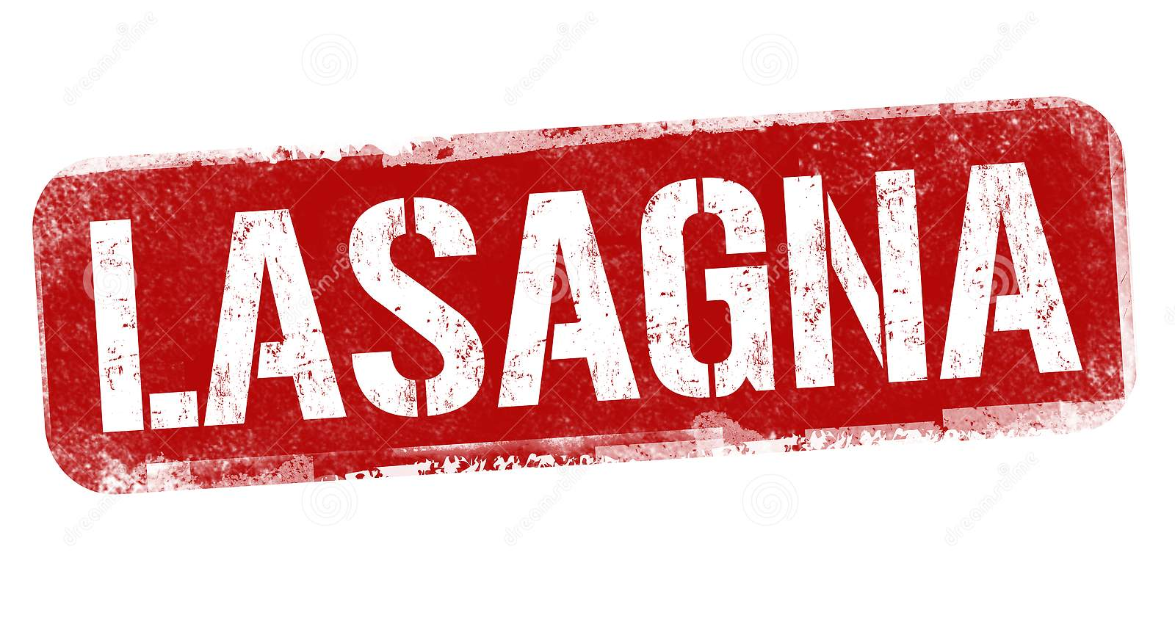
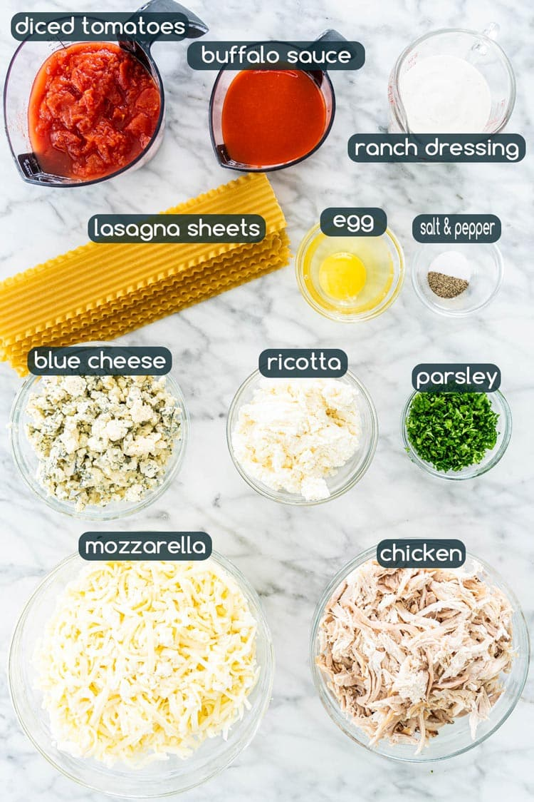
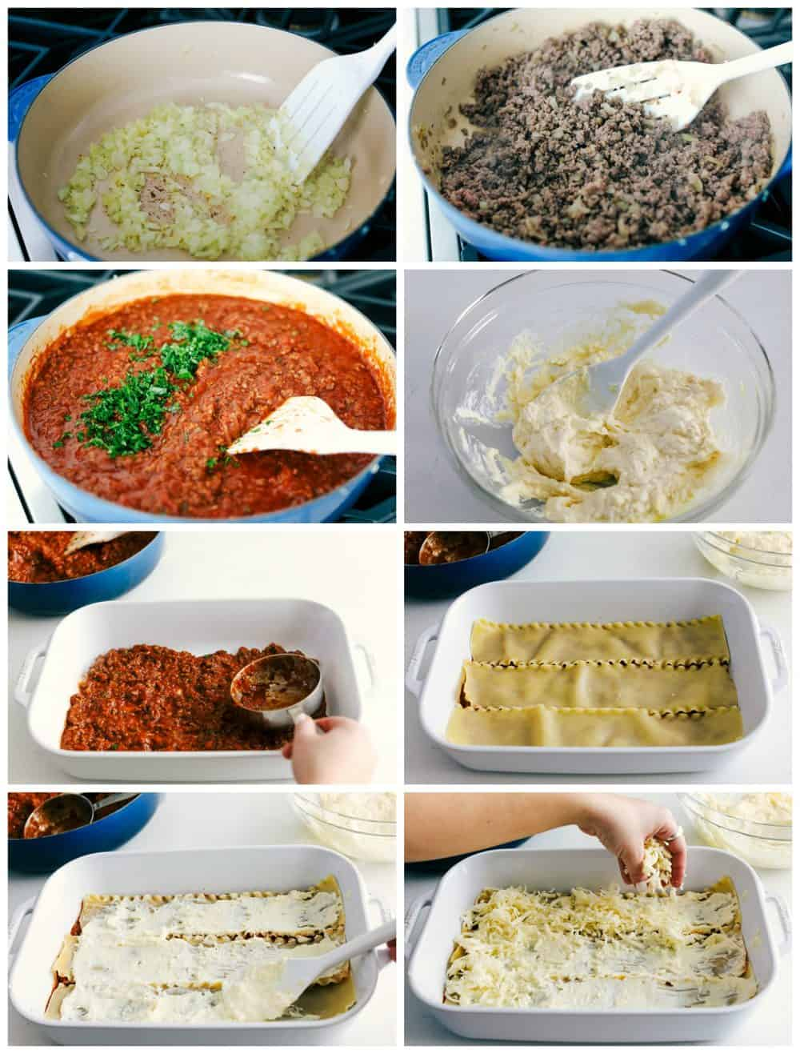
The problem
Retrieving relevant images from a big database - known recipe - unknown recipe
Query
Notes:
I have decided to simplify the problem by altering the domain of the problem.
I have focused on food recipes. More exactly I am NOT looking to create a hierarchy of recipes to improve any labelling
But I want to be able to increase the efficiency of image retrieval. What we want to do is basically .. Find recipes. We suppose that :
- we either have a certain recipe in mind and we know the right word
-or we want to find something that we do not know based on an intuitive word.
--- We have to write a simple query that we think it is appropriate and receive a results that fits the intention.
For example…

Slide 4
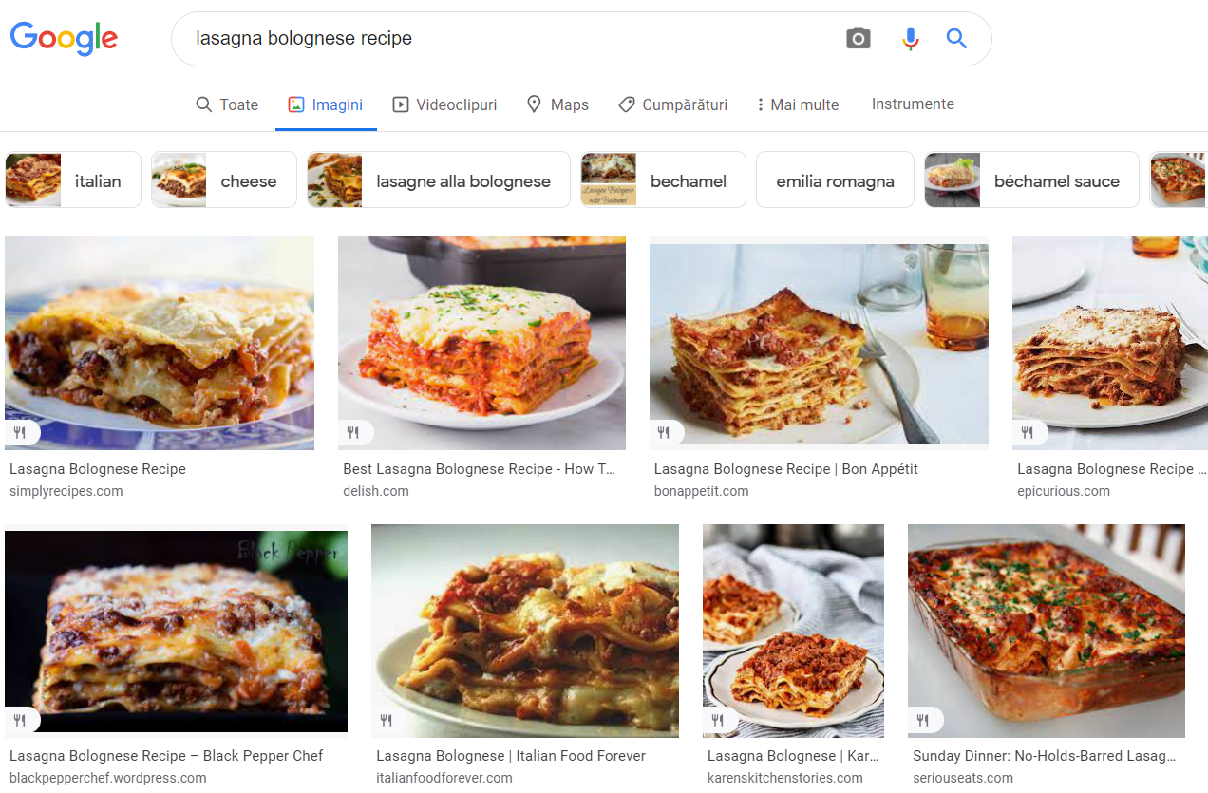
The solution
Use an information retrieval system to obtain relevant images
Notes:
The solution is an information retrieval system for image. For example…

Slide 5
App Flow
Write a query
Initiate search
Receive recommendations
Input: Query
Output: List of images of recipes
Notes:
The user enters the app and
- writes a query consisting of one word in the search bar
The search is initiated and the magic happens in the background
A list of relevant images of different recipes are returned and printed in the interface

Slide 6
The data
Im2recipe – database of 1M recipes
FooDB – scientific database for medical purposes of foods
Notes:
Simple dataset with 1 million entries scrapped from the internet. Each entry is one recipe containing -the name of the recipe/blog post
-the text representing the list of ingredients with much extra wordage
-the text representing the list of steps of preparation
-Contains an auxiliary dataset with image source link for some of the recipes, not all of them ~~
A very complex database I used to extract the food ingredients. It contains a table roughly a 1000 ingredients organized on categories, and many other details.
It also contains many other tables that describe the chemical structure of each ingredient, average contents, the type of each chemical with an insane amount of details, also a rigorous list of anatomical correlations of each chemical. (Like ..

Slide 7
The tools
Owlready2
Enchant
Nltk – wordnet
Re, requests, json, csv
PIL, pysimplegui
Notes:
Owlready2 – library that allows creation and simple querying of an ontology enchant – for a simple function of the levenstein distance
Wordnet – to find synonyms of word
Nltk – to extract root of a word and semantic position
Re – basic string functions
Requests = to download images
Json, csv – format management
PIL, pysimplegui – image operations and user interface construction

Slide 8
Algorithm
Part 1 (The information discovery): - reads all the recipes - reads all the foods - find relevant images - correlates recipe ingredients with foods - ontology initialization
Notes:
This step is required before the use of the main function of image retrieval.
--
… and saves them in a structured form
Correlates the recipe images with the actual recipe from the two databases parts
-goes through the ingredient list and process the string type information from the ingredients attribute which is in raw text format - finds correlation between the ingredients and foods using text processing (root of word, synonym, and the word distance)
- Create the ontology using part of the information

Slide 9
Algorithm
Part 2 (The querying): - initialise the GUI - load the ontology data - query with a world
Notes:
Here I see the first improvement. If the first part of the algorithm took almost an hour to read, load and process. The ontology loading and query-ing takes seconds

Slide 10
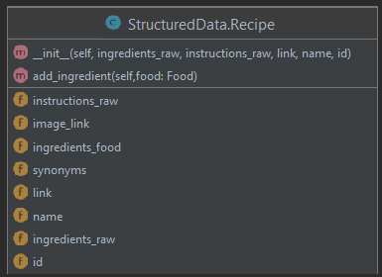
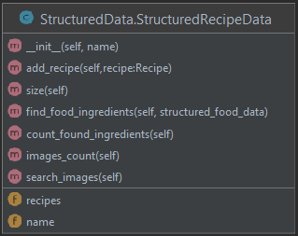
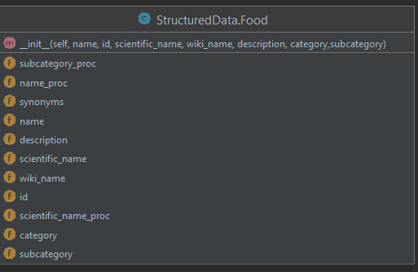
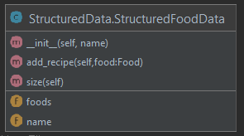
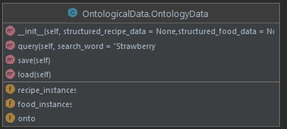
Code structure
The ontology
Notes:
We have the structure that are used to store and preprocess the recipes and the foods. The classes that work as repositories for those. The ontology that saves part of that data.

Slide 11
The ontology
class RecipeOnt(Thing):
pass
class has_for_link(DataProperty):
range = [str]
class has_for_synonym(DataProperty):
range = [str]
class has_for_category(DataProperty):
range = [str]
class FoodOnt(Thing):
pass
class has_for_ingredient(ObjectProperty):
domain = [RecipeOnt]
range = [FoodOnt]
class is_ingredient_of(ObjectProperty):
domain = [FoodOnt]
range = [RecipeOnt]
inverse_property = has_for_ingredient

Slide 12
DEMO
To the APP!

Slide 13
Conclusion
Managed to create an image retrieval system specifically designed for food recipes that works real-time

Slide 14
Future steps
Use of more attributes
Medical extension
Increase the database of recipes through scrapping
Associate to countries and regions

